Slide 1
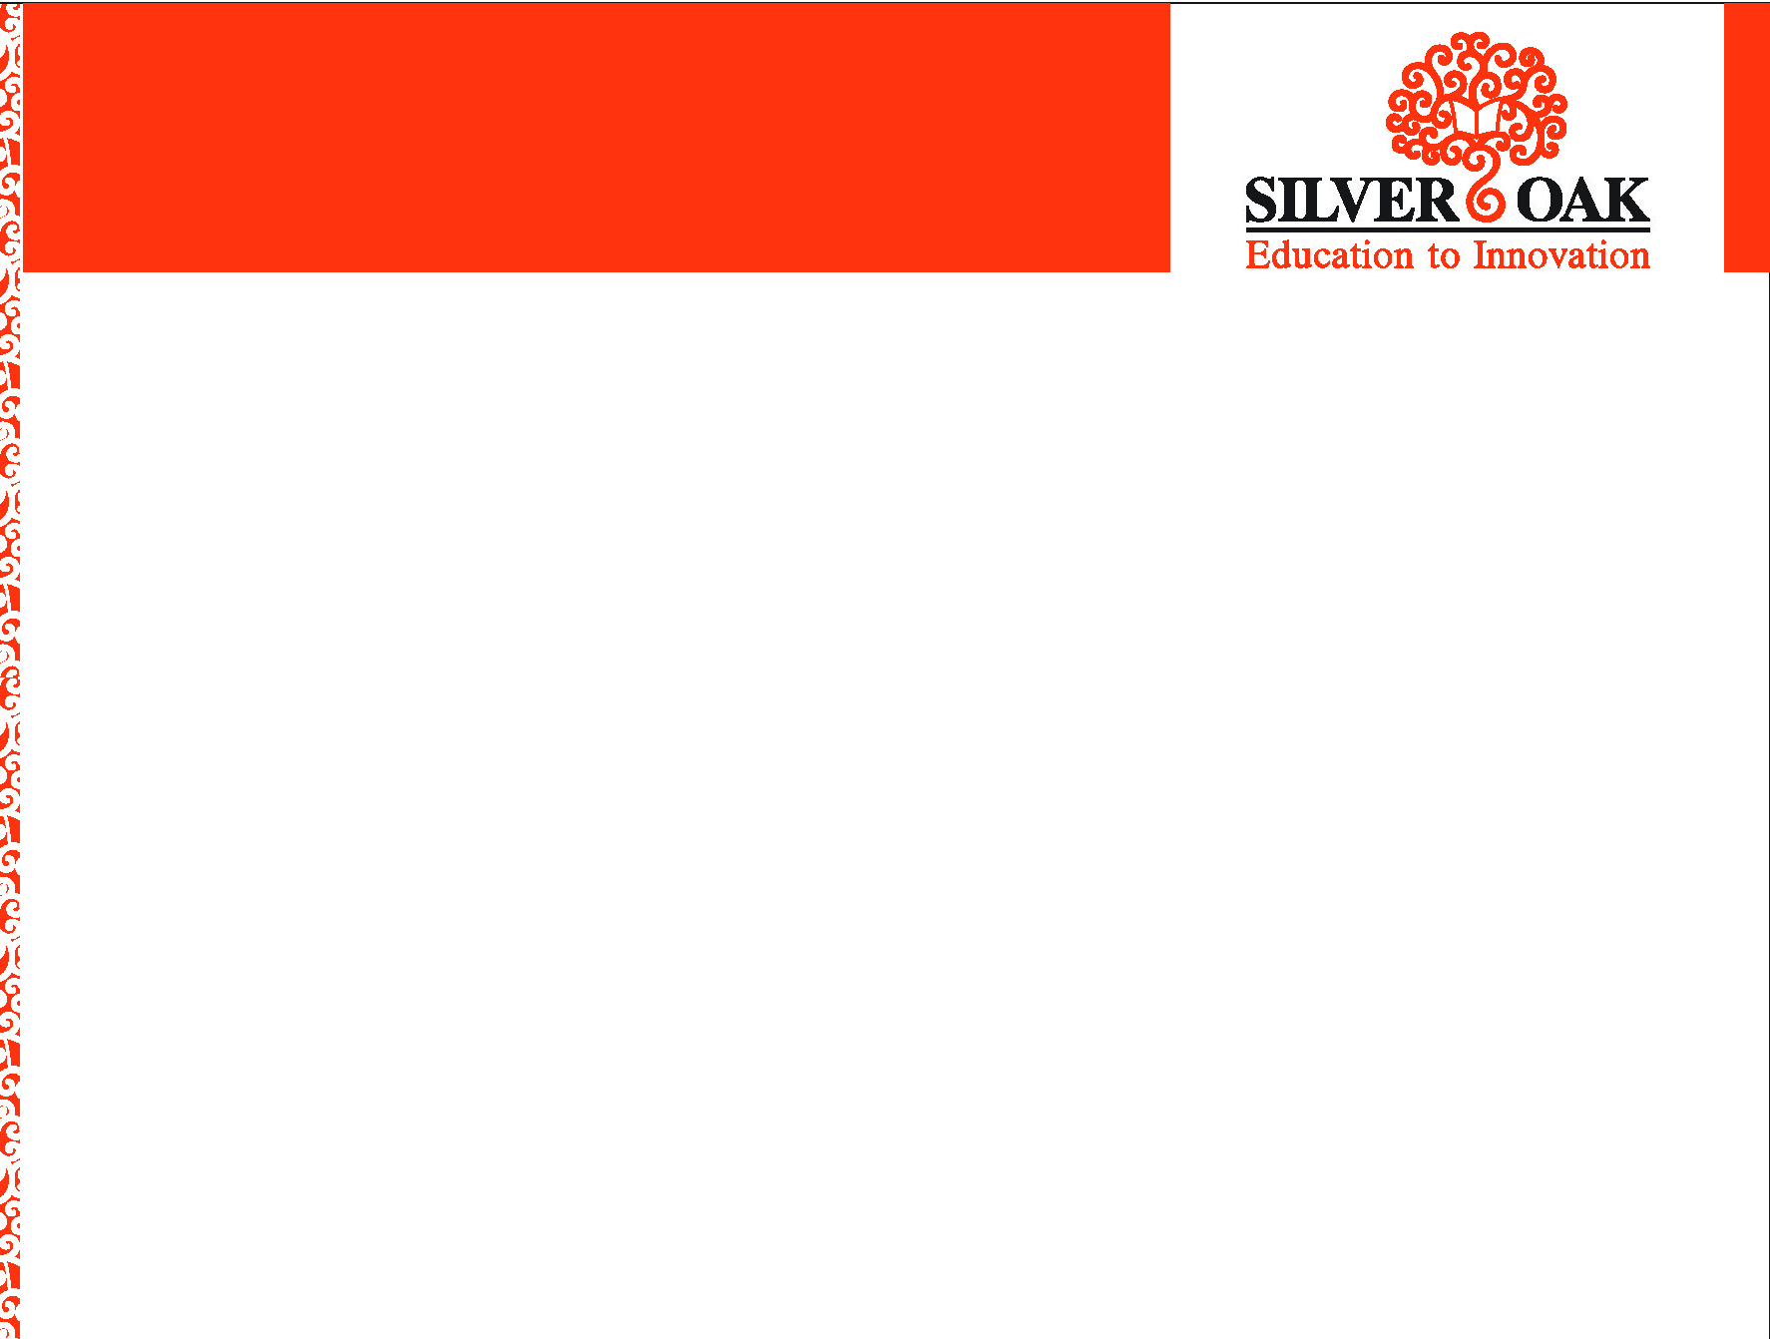
SILVER OAK COLLEGE OF ENGINEERING & TECHNOLOGY
Gender Equality
Group Leader Internal Faculty Guide
Nandaniya Ankit A/Prof. Vishwa Patel
Group Members
2101030700039 - MARADIYA OJAS NITINBHAI
2101030700040 – MOHIT 2101030700041 - MOR KAULESHKUMAR RAMESHBHAI 2101030700042 - MUNDHVA ARYAN MANOJBHAI
2101030700043 - NANDANIYA ANKIT KUMAR KESHAR BHAI
2101030700044 - NEEKHILESHWARI GURJAR

Slide 2
Table of Content
Abstract
Introduction
Literature Survey/Research
Worked carried out till date
Proposed Work
Future Work & Conclusion
Timeline Chart
References

Slide 3
Abstract
This study considers the gender inequality that exists among every region, social class and prevents the growth of Indian economy from improving the lives of Indian people.
The reality of gender inequality in India is very complex and diversified, because it exists in every field like education, employment opportunities, income, health, cultural issues, social issues, economic issues etc.
An attempt has been made to find out those factors which are responsible for this problem in India.
Overall, the study indicates the inequality in economic, social, cultural and legal biasness which are of a great challenge for policy-makers and social scientists to establish proper equality in the entire social field.
The researchers have tried to suggest some relevant strategies and policies implication for reducing this gender inequality and to promote the dignified position for Indian women.

Slide 4
Introduction
Every child deserves to reach her or his full potential, but gender inequalities in their lives and in the lives of those who care for them hinder this reality.
Globally girls have higher survival rates at birth, are more likely to be developmentally on track, and just as likely to participate in preschool, but India is the only large country where more girls die than boys. Girls are also more likely to drop out of school.
India will not fully develop unless both girls and boys are equally supported to reach their full potential.
Some Indian women are global leaders and powerful voices in diverse fields but most women and girls in India do not fully enjoy many of their rights due to deeply entrenched patriarchal views, norms, traditions and structures.

Slide 5
Introduction
The solution:-
It is critical to enhance the value of girls by investing in and empowering them, with education, life skills, sport and much more.
Changing the value of girls has to include men, women and boys. It has to mobilize many sectors in society. Only when society’s perception changes, will the rights of all the girls and all the boys in India be fulfilled.
Empowering girls requires focused investment and collaboration. Providing girls with the services and safety, education and skills they need in daily life can reduce the risks they face and enable them to fully develop and contribute to India’s growth .

Slide 6
Literature Survey/Research
Girls and boys see gender inequality in their homes and communities every day – in textbooks, in the media and among the adults who care for them.
Parents may assume unequal responsibility for household work, with mothers bearing the brunt of caregiving and chores.
The majority of low-skilled and underpaid community health workers who attend to children are also women, with limited opportunity for professional growth.
Worldwide, nearly 1 in 4 girls between the ages of 15 and 19 are neither employed nor in education or training – compared to 1 in 10 boys.

Slide 7
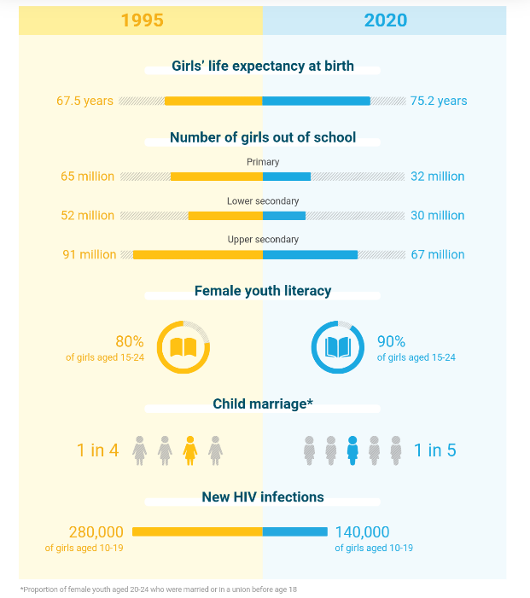
Literature Survey/Research

Slide 8
Worked carried out till date
In this project, the work we have completed are as follow:
Analysing the topic
Collect the information about Indian heritage awareness
Study the Literature Review
Find out the problem due to lower awareness
Solution to increase the awareness of Indian gender inequality.

Slide 9

Proposed Work
1. Make a longer shortlist when recruiting
Gender inequities can be inherent in informal recruitment processes, particularly in male-dominated industries.
To address this, recruiters should make their informal shortlist longer, suggest researchers writing in the Harvard Business Review. Adding an additional three candidates to an initial shortlist of three saw the women-to-men ratio rise from 1:6 on the original list, to 1:4 on the extended one, their study showed.
2. Remove the gender pay gap
The gender pay gap measures the difference in average earnings between male and female employees. In 2020, women worldwide earned 81 cents for every US dollar earned by men, according to Statista.
While this has improved over the years – up from 74 cents in 2015 – more work is needed, particularly as women are still less likely to negotiate their salary.

Slide 10
Proposed Work
3. Use skills-based assessments
Employers in the UK are encouraged to use skills-based assessments and structured interviews when recruiting, to reduce the risk of unfair bias.
Asking candidates to perform tasks they would be expected to carry out in the role they are applying for, enables organizations to assess their suitability based on their performance, says a report from the Government Equalities Office.
These tasks need to be standardized across all applicants to ensure fairness.
4. Have women mentor men
Another way to improve gender equality in the workplace is by letting women mentor men.
Mentoring in the workplace can prove invaluable in helping an employee progress their career.
The benefits of junior business women having a mentor to help break the barriers they face are well documented.

Slide 11
Opportunity for girls
India will not fully develop unless both girls and boys are equally supported to reach their full potential. There are risks, violations and vulnerabilities girls face just because they are girls. Most of these risks are directly linked to the economic, political, social and cultural disadvantages girls deal with in their daily lives. This becomes acute during crisis and disasters.

Slide 12
Education
Gender responsive support to enable out-of-school girls and boys to learn and enabling more gender-responsive curricula and pedagogy (Example: implementing new strategies for identifying vulnerable out of school girls and boys, overhaul of textbooks so that the language, images and messages do not perpetuate gender stereotypes)

Slide 13
Benefits of Women in Business Industry
Flexibility at workplace The rise in number of women at workplace has made an organisation to give a closer look at the difficulties of their employees and staff. With the coming of women to the workforce, the management has done many positive changes to bring several new programs that will advantage both male and female employees. Facilities like childcare, ATM machine at work, work from home, elder care, oil change and much more, which were not offered by the management before women started to enter the workforce.

Slide 14
Benefits of Women in Business Industry
Smooth and effective communication Women are found to be a great communicators as they respond more excellently to visual, verbal and sensitive factors than men. Women are awarded with strong communication and networking skills using which they can encourage any collaborative or group work efforts. Also, women eavesdrop to team members carefully, share ideas, and give the assistance to encourage teamwork, while upholding professionalism

Slide 15
Challenges of Gender Equity
Common obstacles and how to overcome them
Resistance
Lack of understanding of gender equality and/or a Gender Equality Plan
Conviction that commitment to merit and/or excellence negates the need for gender equality work and/or Gender Equality Plans
Perception that gender equality work is not required or denial

Slide 16
How Can We Stop Gender Inequality!
SHARE HOUSEHOLD CHORES AND CHILDCARE EQUALLY
WATCH FOR SIGNS OF DOMESTIC VIOLENCE
SUPPORT MOTHERS AND PARENTS
REJECT CHAUVINIST AND RACIST ATTITUDES
HELP WOMEN GAIN POWER
LISTEN AND REFLECT
HIRE DIVERSITY
PAY (AND DEMAND) THE SAME SALARY FORE EQUAL WORK

Slide 17
Difference between Gender Equality and Inequality.
Gender equality requires equal enjoyment by women and men opportunities resources and rewards. where gender inequality exists, it is generally woman who are excluded or disadvantaged in relation to decisionmaking and access to economic and social resources

Slide 18
Difference between Gender Equality and Inequality.
The paper makes an attempt to compare gender inequality in a developed (USA) and developing (India) country on dimensions such as education, health, labour force participation and politics based on Gender Data Portal of World Bank for the period 2007–2017. In terms of Government Expenditure on Education, USA spends much more than India on education. The number of out of schoolchildren has decreased for India but has increased for USA from 2007 to 2013.

Slide 19
Difference between Gender Equality and Inequality.
Primary and Secondary School enrolment has also shown an increase in India while a decline in USA. Gender inequality continues to have a negative impact on many health outcomes of Indian women. USA women fare better than Indian women at all indicators studied. The paper argues that if economic growth was the only criterion for labour force participation, then there should not be disparity among LFPR of males and females in USA, but lower LFPR for females than males in USA reflects disparity among males and females.

Slide 20
Difference between Gender Equality and Inequality.
About 81.94% of females in India were self-employed in 2017 as compared to only 7.34% in USA. India and USA both fare poorly in political participation of women. The paper thus concludes that although India performs poorly across various socio-economic indicators as compared to USA, one can say that there is no perfect gender equality in any of these two countries.

Slide 21
Facts About Gender Equity
In 2015 there only 21 female heads of state in the entire world
Over 150 countries have at least one actively sexist law
Each minute 28 girls are married before they are ready
1 in 3 women have experienced physical or sexual violence at some point in their lifetime

Slide 22
Future Work & Conclusion
To collect detailed information about indian gender inequality.
Sort that by share information , videos and implement that in website.
Create informative website of indian Gender inequality in following steps:
1. Gather information
2. Discuss and make a plan
3. Design website
4. functionalities like user can filter information by years and types of gender inequality and also can know there thoughts on that inequality, share review on site and share suggestions on website.
5. Testing website
6. Launch website

Slide 23
Time Line Chart
Sr. No. | Title | Time Periods
1 | Selection and analyzing the topic | 1 days
2 | Study the literature review | 2 days
3 | Find out the problem due to lower awareness | 3 days
4 | Solution to increase the awareness of Indian cultural heritage among the youth | 3 days
5 | Working on preparing website | 2 months
6 | Conclude the project | 10 days

Slide 24
References
https://www.su.se/polopoly_fs/1.82832.1333022556!/menu/standard/file/WP_2011_7.pdf
https://core.ac.uk/download/pdf/61456858.pdf
https://www.unicef.org/gender-equality
https://www.unicef.org/india/what-we-do/gender-equality

Slide 25
Thank You..!
Any Questions?🤔

